Slide 1





TELECOM NETWORK ANALYTICS
Network Performance Analysis
From raw network data to decisions — Python analysis, machine learning,
and interactive Power BI, Tableau & Excel dashboards.
Python (EDA + ML)
Power BI
Tableau
Excel
Prepared with Python · Power BI · Tableau · Excel

Slide 2





PROJECT OVERVIEW
The Business Question
“What factors have the greatest impact on
telecom network performance?”
DATASET SNAPSHOT
3,605
rows of network readings
8
The analysis tests four candidate drivers of download speed, upload speed, and latency:
Weather conditions
columns per reading
0
Number of connected users
missing values
Time of day (hour)
0
Network congestion level
duplicate rows
Columns: timestamp, tower_id, users_connected, download_speed, upload_speed, latency, weather, congestion
Telecom Network Performance Analysis
2

Slide 3






APPROACH
Analysis Workflow
1
2
3
Import & Load
Explore
Clean
Load network readings into pandas; import numpy, seaborn, matplotlib, scikit-learn.
Profile shape, dtypes, summary stats; check nulls, duplicates and IQR outliers.
Convert timestamp to datetime; engineer an hour-of-day feature.
4
5
6
Ask & Answer
Visualize
Model
Run 6 business questions on weather, users, time and congestion.
Heatmaps, scatter plots, regression and bar-chart visuals for each finding.
Train a Linear Regression model to predict download speed.
Telecom Network Performance Analysis
3

Slide 4
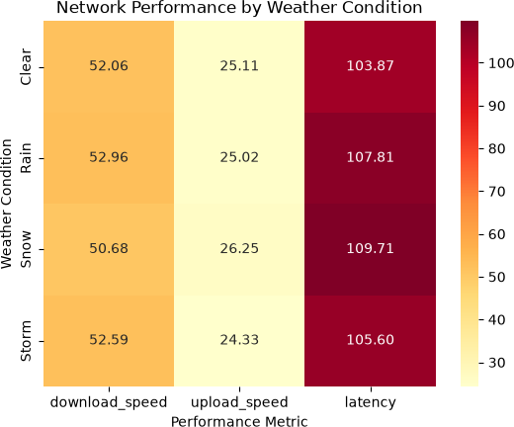
INSIGHT 01
Does Weather Affect Performance?
Q1 — Does weather condition affect network performance?
FINDING Download speed, upload speed and latency show only small differences across weather conditions in the heatmap.
CONCLUSION Weather does not appear to be a major factor affecting network performance in this dataset.
Telecom Network Performance Analysis
4

Slide 5
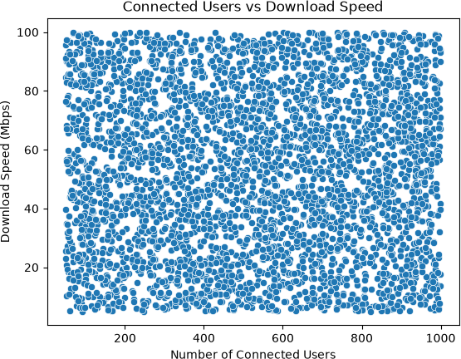
INSIGHT 02
Do More Users Slow the Network?
Q2 — Does the number of connected users affect performance?
FINDING The correlation between connected users and download speed is only 0.02 — effectively zero.
CONCLUSION The number of connected users shows no significant linear relationship with download speed in this dataset.
Telecom Network Performance Analysis
5

Slide 6
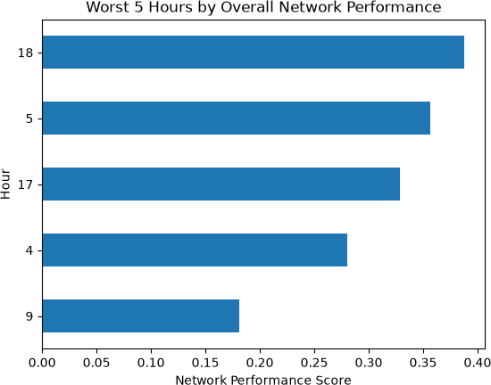
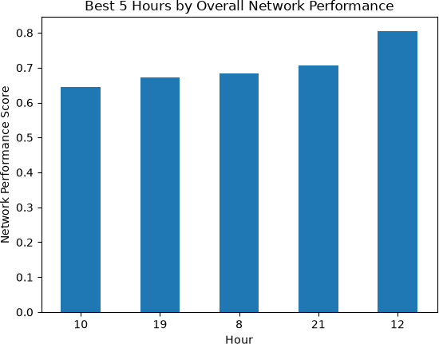
INSIGHT 03
Best & Worst Performance Hours
Q3 — Worst hours
Q4 — Best hours
FINDING Download speed is lowest at 09:00 (46.14 Mbps) and highest at 18:00 (58.14 Mbps). Upload speed is lowest at 22:00 (22.91 Mbps) and highest at 15:00 (27.04 Mbps). Latency is highest (worst) at 14:00 (112.96 ms) and lowest (best) at 08:00 (96.16 ms).
CONCLUSION There is no single worst or best hour across all metrics — but time of day clearly shapes performance, useful for capacity planning.
Worst hour: 9 AM • score 0.18
Best hour: 12 PM • score 0.80
Telecom Network Performance Analysis
6

Slide 7
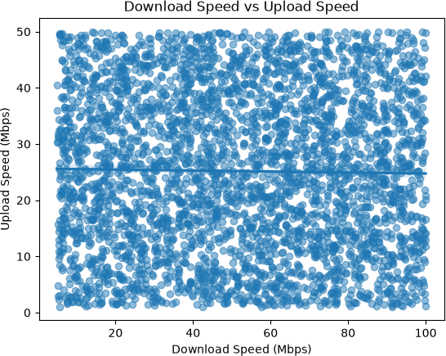
INSIGHT 04
Download Speed vs Upload Speed
Q5 — Is there a relationship between download and upload speed?
FINDING The correlation between download speed and upload speed is -0.02 — very close to zero, with a nearly flat trend line.
CONCLUSION There is no clear linear relationship between download speed and upload speed in this dataset.
Telecom Network Performance Analysis
7

Slide 8
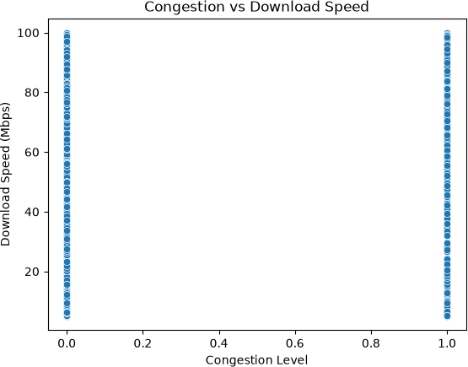
INSIGHT 05
Does Congestion Hurt Performance?
Q6 — Does network congestion affect performance?
FINDING Congestion shows almost no linear relationship with download or upload speed (correlation ≈ 0.00 and -0.01) — but a moderate positive correlation of 0.31 with latency.
CONCLUSION Congestion is the first factor to show a clear linear effect — but that effect lands on latency, not on download or upload speed.
Telecom Network Performance Analysis
8

Slide 9
BRINGING IT TOGETHER
Correlation Summary Across All Factors
Only one relationship stood out
0.31 Congestion → Latency The only moderate correlation found across every factor tested.
All other correlations sit between -0.02 and 0.02 — essentially no linear relationship.
Telecom Network Performance Analysis
9

Slide 10
MODELING
Can We Predict Download Speed?
MODEL Linear Regression, trained on an 80 / 20 split with one-hot encoded weather.
23.55
MAE Mbps average error
27.42
RMSE Mbps root-mean-sq. error
FEATURES USED
users_connected
upload_speed
latency
weather
congestion
hour
0.0011
R² Score ≈ zero explanatory power
TARGET
download_speed
The R² close to zero confirms: no single available feature strongly or directly predicts download speed.
Telecom Network Performance Analysis
10

Slide 11



BEYOND PYTHON
Three Interactive Dashboards
The same network data was rebuilt as live, filterable dashboards in three
leading BI tools — each suited to a different audience and workflow.
Power BI
Tableau
Excel
Executive KPI overview with regional slicers
15-view exploratory analysis workbook
Pivot-table congestion & capacity dashboard
Telecom Network Performance Analysis
11

Slide 12



DASHBOARD 01
Power BI — Network Performance Overview
A single executive page combining KPI cards, distribution charts and a time trend, filterable by region, city and weather.
KPI Cards
Distribution Charts
Trend & Detail
Average download speed
Average upload speed
Maximum latency recorded
Donut: connected users by network type
Donut: tower count & avg. latency
Pie: reading count by weather
Line chart: avg. download & upload speed over time
Scatter: connected users vs. download speed
Slicers: region, city & weather filters
Best for Executives and stakeholders who need a fast, at-a-glance read on network health by region.
Telecom Network Performance Analysis
12

Slide 13
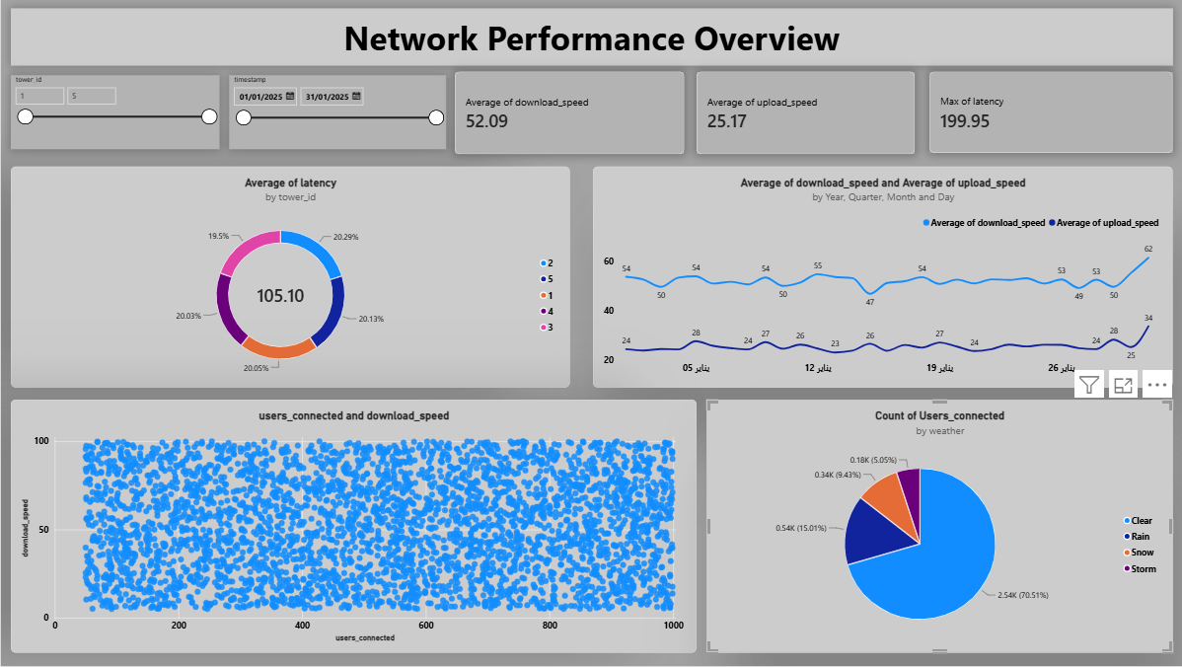
01
DASHBOARD 01 — SCREENSHOT WALKTHROUGH
Power BI — Inside the Network Performance Overview
The live report page, built on the same cleaned dataset, with cross-filtering slicers for tower ID, install year, region/city, weather and network type.
What each visual on the page shows
KPI cards up top
Average download speed (52.88 Mbps), average upload speed (24.71 Mbps) and max latency (199.49 ms) update live as slicers change.
Latency & users donuts
A donut shows average latency by tower_id (106.28 ms for the selected towers), and a second donut sums connected users by network type — 274K on 4G.
Speed trend line
Average download vs. upload speed plotted by year, quarter, month and day, so drops or spikes over the trial period are easy to spot.
Scatter + weather donut
A users-connected vs. download-speed scatter checks for a load effect, and a weather donut confirms the sample used is filtered to Clear conditions.
Slicer panel
Tower ID range slider, install year, region/city, weather and network type let a viewer isolate any slice of the network in one click.
Telecom Network Performance Analysis
13

Slide 14

DASHBOARD 02
Tableau — Exploratory Analysis Workbook
“Dashboard 1” assembles 15 focused worksheets into one filterable exploratory view of network health.
KPI Summary Cards
Trends Over Time
Breakdown Views
Avg. download speed
Avg. upload speed
Avg. latency
Avg. connected users
Latency, download & upload line trends
Area chart: users connected vs. weather
Network quality by weather (square marks)
Congestion share (pie)
Weather-driven % breakdown (pie)
Weather vs. download / upload comparison
Best for Analysts who want to dig deeper — every view responds to a shared weather filter for instant drill-down.
Telecom Network Performance Analysis
14

Slide 15
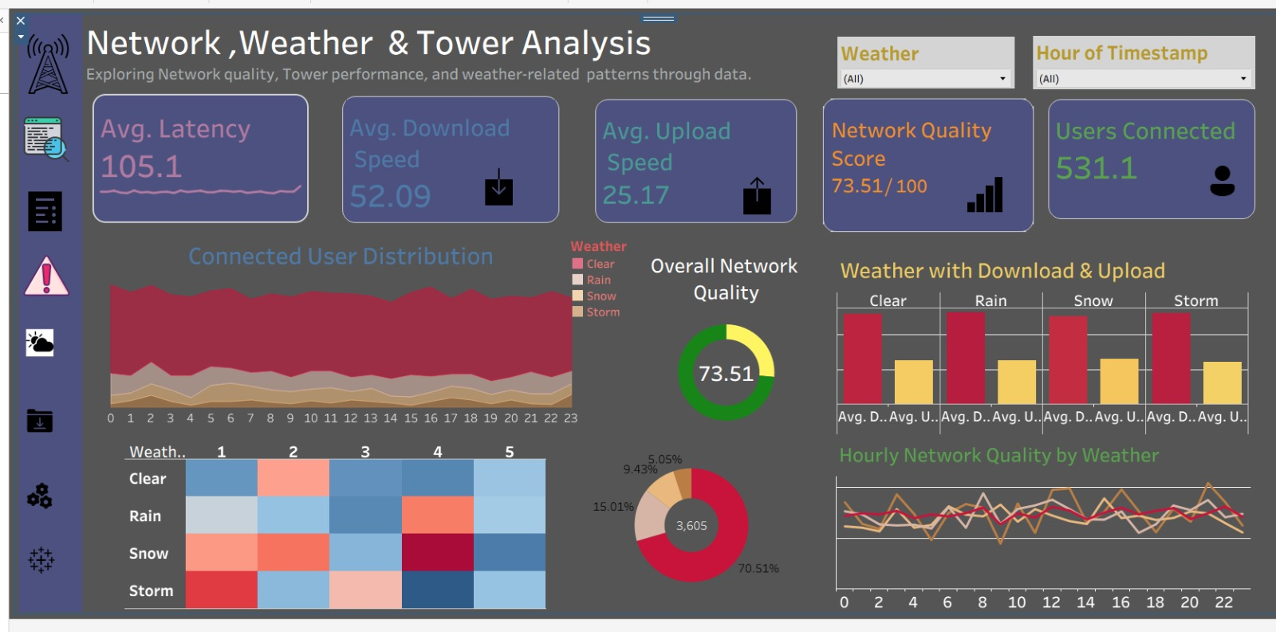
02
DASHBOARD 02 — SCREENSHOT WALKTHROUGH
Tableau — Inside the Network, Weather & Tower Analysis
A dark-themed exploratory dashboard combining a custom Network Quality Score with weather- and hour-level breakdowns, filterable by weather and hour of day.
What each visual on the page shows
KPI strip
Five headline cards: avg. latency (105.1 ms), avg. download (52.09 Mbps), avg. upload (25.17 Mbps), a calculated Network Quality Score (73.51/100), and avg. connected users (531.1).
Connected user distribution
A stacked area/stream chart shows connected users across the 24-hour clock, coloured by weather condition (Clear, Rain, Snow, Storm).
Overall network quality donut
The 73.51 score is broken into weather contribution shares (about 62% Clear, 19% Rain, 12% Snow, 7% Storm) so the biggest driver of the score is visible at a glance.
Weather x score heatmap
A weather (rows) by quality-band (1–5, columns) heat grid highlights which weather condition most often lands in the low- or high-quality bands.
Weather bars + hourly line
Grouped bars compare avg. download vs. upload per weather type, and a multi-line chart tracks hourly network quality separately for each weather condition.
Telecom Network Performance Analysis
15

Slide 16


DASHBOARD 03
Excel — Congestion & Capacity Dashboard
A PivotTable-driven dashboard sheet with a Region slicer, built on top of six supporting pivot tables.
Congestion Views
Network Capacity
Interactivity
Congestion by hour of day
Congestion status distribution
Load band vs. congestion status
Most congested towers, ranked
Capacity by city
Overall congestion rate
Users connected vs. congestion
Region slicer for live filtering
One-page dashboard summary
Best for Operations teams tracking congestion hot spots and capacity limits tower-by-tower, city-by-city.
Telecom Network Performance Analysis
16

Slide 17
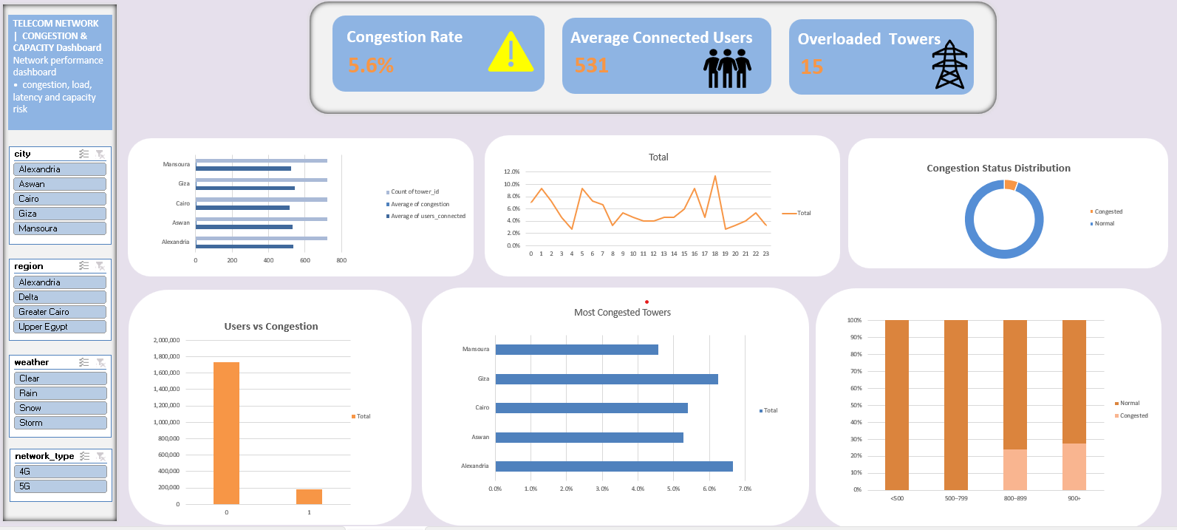
03
DASHBOARD 03 — SCREENSHOT WALKTHROUGH
Excel — Inside the Congestion & Capacity Dashboard
A single PivotTable-driven sheet stitched together from six supporting PivotTables, with city, region, weather and network-type slicers wired to every chart.
What each panel on the sheet shows
KPI banner
Three live cards: overall Congestion Rate (5.6%), Average Connected Users (531) and count of Overloaded Towers (15), all recalculating with the slicers.
City & hourly views
A horizontal bar ranks tower count, avg. congestion and avg. users by city, next to a 24-hour line chart of total congestion — the two supporting pivots covered on the next slides.
Status split & load bands
A donut breaks congestion into Congested vs Normal, and a stacked bar shows that split across four connected-user load bands (<500, 500–799, 800–899, 900+).
Users vs congestion & towers
A bar compares raw congestion (0/1) volumes against connected users, and a second bar ranks the most congested cities/towers from Alexandria down to Mansoura.
Slicer panel
City, region, weather and network_type slicers on the left let anyone filter the whole dashboard down to a single city or condition without touching a formula.
Telecom Network Performance Analysis
17

Slide 18
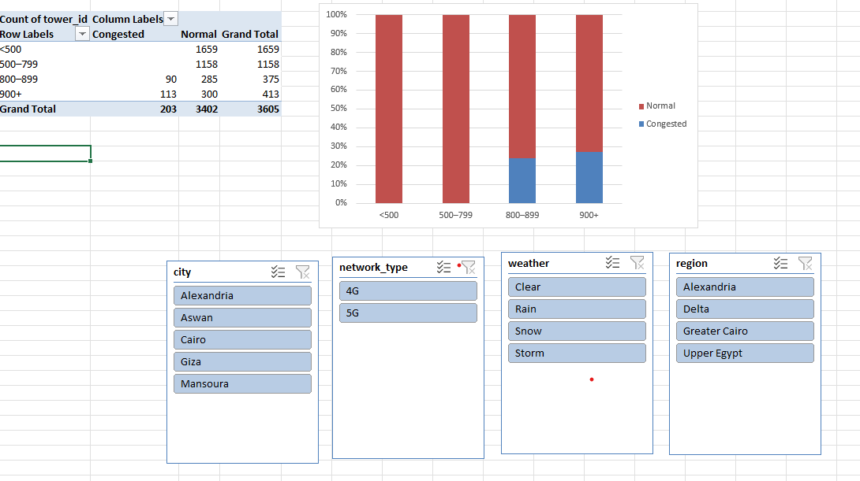
04
EXCEL — SUPPORTING PIVOTTABLE 1 of 5
PivotTable: Congestion Status by Connected-User Load Band
Row field is a custom load-band grouping of users_connected; column field is congestion_status; values are counts of tower_id readings.
Reading the PivotTable
How it is built
Rows = load band (<500, 500–799, 800–899, 900+ connected users); Columns = Congested / Normal; Values = Count of tower_id, fed by the city, network_type, weather and region slicers.
Low load = always normal
Every reading under 800 connected users (1,659 in the <500 band and 1,158 in the 500–799 band) comes back Normal — zero congestion at low load.
Congestion only appears at high load
Congestion only shows up once load passes 800 users: 90 of 375 readings (24%) in the 800–899 band, and 113 of 413 readings (27%) in the 900+ band.
Chart translation
The 100% stacked bar turns this into a clear visual: two solid red bars for the low-load bands, then a growing blue "Congested" slice appears for the two high-load bands.
Why it matters
This is the strongest evidence in the whole workbook that congestion is a high-load-band phenomenon, not something spread evenly across the network.
Telecom Network Performance Analysis
18

Slide 19
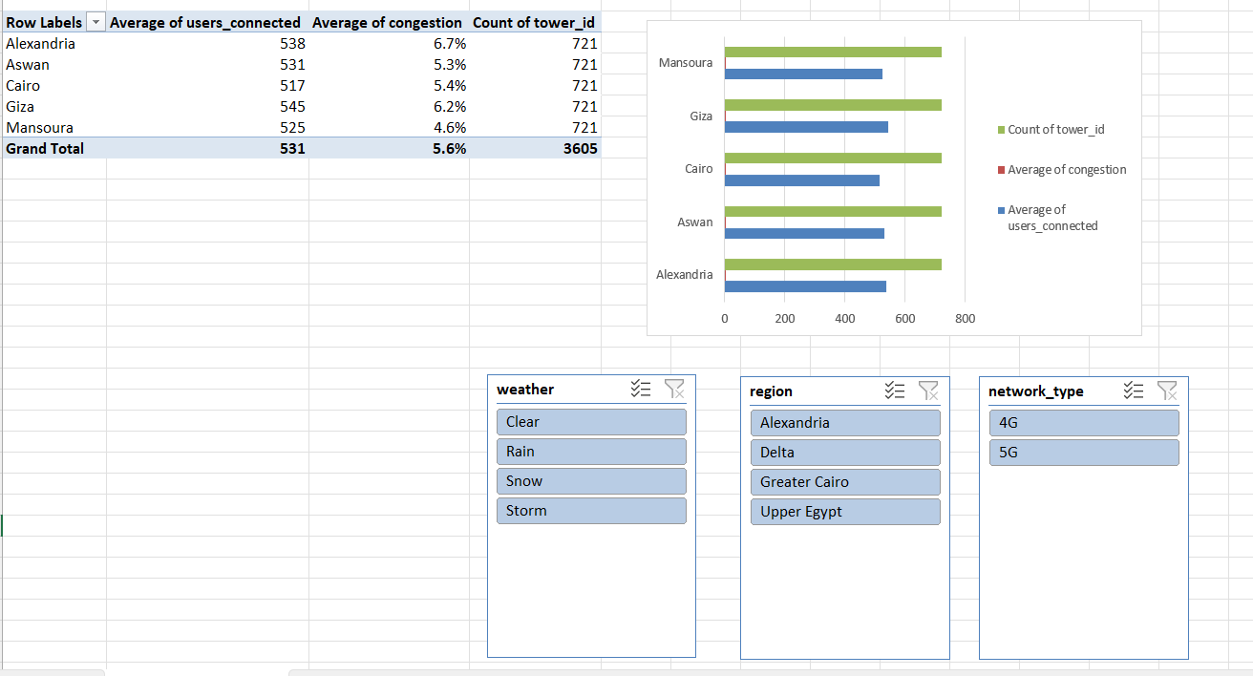
05
EXCEL — SUPPORTING PIVOTTABLE 2 of 5
PivotTable: Network Snapshot by City
Row field is city; values are Average of users_connected, Average of congestion and Count of tower_id, driven by the weather, region and network_type slicers.
Reading the PivotTable
How it is built
Rows = city (Alexandria, Aswan, Cairo, Giza, Mansoura); Values = Average users_connected, Average congestion (%), Count of tower_id readings — 721 readings per city, 3,605 in total.
Users are fairly even
Average connected users sit in a tight band across cities: 517 (Cairo) to 545 (Giza), against a network-wide average of 531 — no single city is dramatically busier.
Congestion is where cities diverge
Average congestion ranges from 4.6% (Mansoura, the calmest) up to 6.7% (Alexandria, the most congested) — a real gap even though user load is similar.
Chart translation
The horizontal bar chart layers count of towers, avg. congestion and avg. users per city, making Alexandria and Giza stand out as the two cities worth prioritising for capacity work.
Why it matters
This pivot is the one that first flags Alexandria as a hotspot — a finding the "Most Congested Towers" pivot on the next slide confirms and ranks in full.
Telecom Network Performance Analysis
19

Slide 20
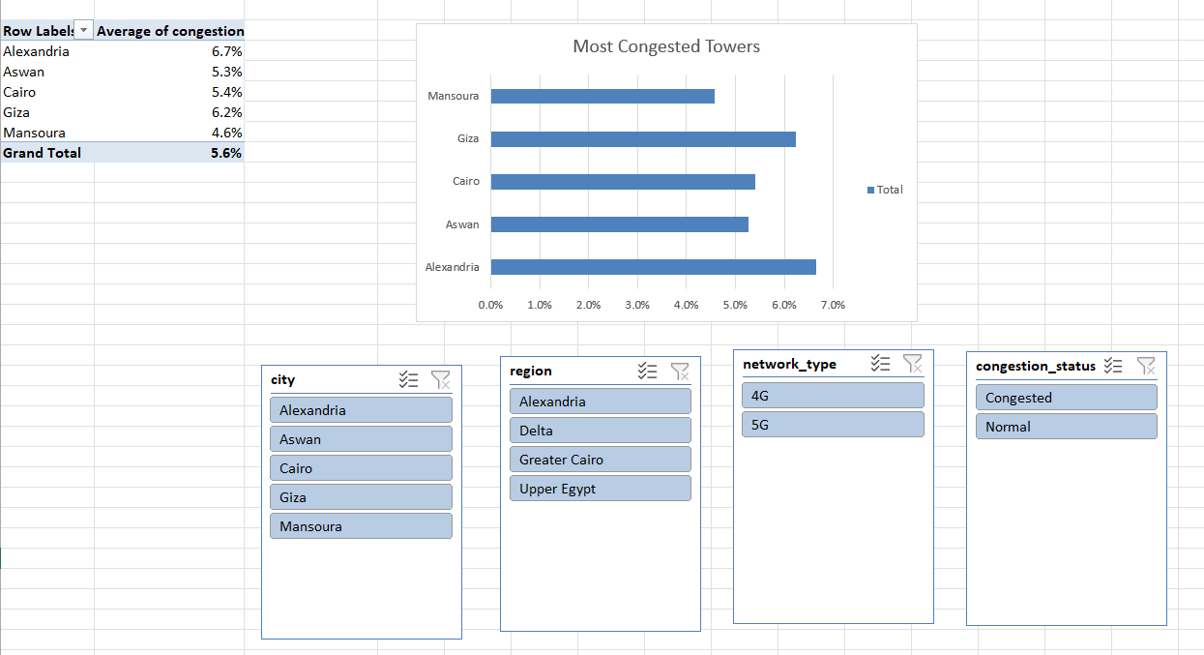
06
EXCEL — SUPPORTING PIVOTTABLE 3 of 5
PivotTable: Most Congested Cities, Ranked
Row field is city; the single value is Average of congestion, sorted to drive the "Most Congested Towers" ranked bar chart.
Reading the PivotTable
How it is built
Rows = city; Values = Average congestion (%); filtered live by city, region, network_type and congestion_status slicers so the ranking can be recomputed for any 4G/5G or Normal/Congested subset.
The ranking
Alexandria tops the list at 6.7% average congestion, followed by Giza (6.2%), Cairo (5.4%), Aswan (5.3%) and Mansoura lowest at 4.6% — against a 5.6% network-wide average.
Chart translation
The horizontal bar chart lists cities from most to least congested, giving a one-glance answer to "where should capacity upgrades happen first?"
Congestion_status slicer
Because the sheet also carries a congestion_status slicer, the same ranking can be recomputed for only the already-Congested readings to see which city contributes most to the problem.
Why it matters
This is the pivot the dashboard's "Overloaded Towers: 15" KPI and the city bar chart draw from directly — it is the operational priority list for the network team.
Telecom Network Performance Analysis
20

Slide 21
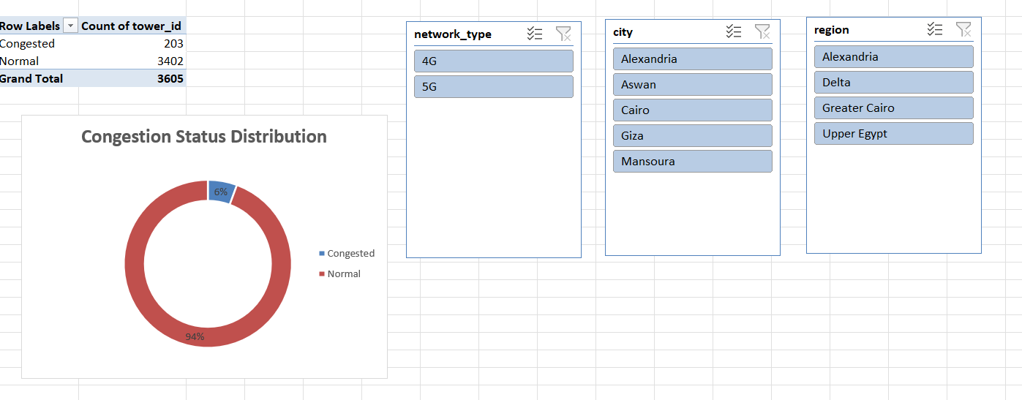
07
EXCEL — SUPPORTING PIVOTTABLE 4 of 5
PivotTable: Overall Congestion Status Split
Row field is congestion_status; the value is Count of tower_id, powering the donut used as the dashboard's headline congestion-rate visual.
Reading the PivotTable
How it is built
Rows = Congested / Normal; Values = Count of tower_id; sliced live by network_type, city and region so the split can be checked for any subset of the network.
The numbers
Out of 3,605 total readings, 203 are flagged Congested and 3,402 are Normal — a 5.6% network-wide congestion rate, matching the KPI card on the main dashboard.
Chart translation
The donut renders this as a small 6% blue slice against a 94% red ring, making the point instantly: congestion is real but affects a small minority of readings.
Why a donut here
A two-category split like Congested vs Normal is exactly the case a donut/pie is built for — one glance answers "is congestion rare or common?" without reading numbers.
Why it matters
This is the single source of truth behind the 5.6% Congestion Rate KPI repeated across the Power BI, Tableau and Excel dashboards.
Telecom Network Performance Analysis
21

Slide 22
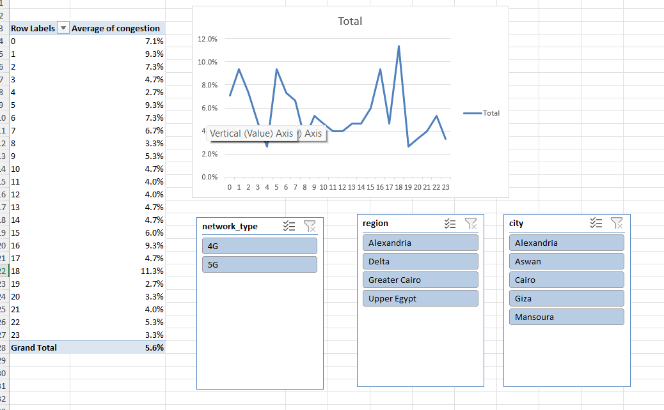
08
EXCEL — SUPPORTING PIVOTTABLE 5 of 5
PivotTable: Average Congestion by Hour of Day
Row field is hour (0–23); the value is Average of congestion, powering the "Total" line chart on the main dashboard.
Reading the PivotTable
How it is built
Rows = hour of day (0 through 23); Values = Average congestion (%); sliced live by network_type, region and city so any city's hourly pattern can be isolated.
A choppy pattern, not a smooth curve
Congestion swings hour to hour rather than following one clean peak — values range from a low of 2.7% (hours 3 and 19) up to a high of 11.3% at hour 18 (6 PM).
Evening stands out
Hour 18 is the clearest spike in the series at 11.3%, roughly double the 5.6% network-wide average, consistent with an evening usage peak.
Chart translation
The line chart plots all 24 hourly averages against the 0–12% axis, so peaks like hour 18 (and the smaller peaks around hours 1, 5 and 17) are easy to spot at a glance.
Why it matters
This pivot is what lets the recommendations slide argue for planning capacity by time-of-day rather than by raw user counts alone.
Telecom Network Performance Analysis
22

Slide 23

WRAPPING UP
Key Findings
Weather has only a weak effect on performance.
RECOMMENDATIONS
User load doesn't meaningfully affect download speed (r = 0.02).
Plan capacity around time-of-day patterns, not user counts alone.
Investigate congestion as a latency-reduction lever, separate from speed upgrades.
Collect richer features (signal strength, tower hardware, backhaul type) to improve future prediction models.
Use the three dashboards for different audiences: Power BI for executives, Tableau for analysts, Excel for operations teams.
Time of day is the clearest driver — performance swings across the day.
Congestion moderately raises latency (r = 0.31), not speed.
Linear regression can't predict download speed from these features (R² ≈ 0).
Telecom Network Performance Analysis
23

Slide 24

Thank You
Telecom Network Performance Analysis — Python · Power BI · Tableau · Excel

